Slide 1
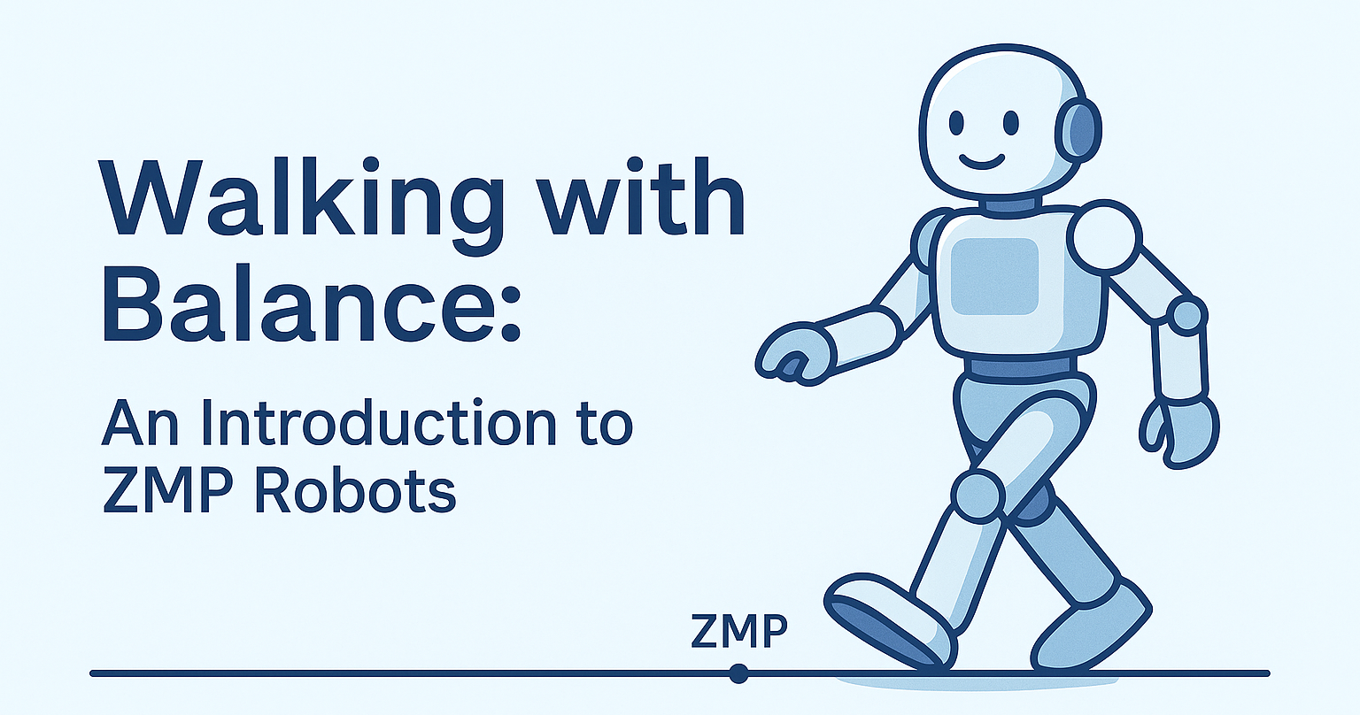

Slide 2
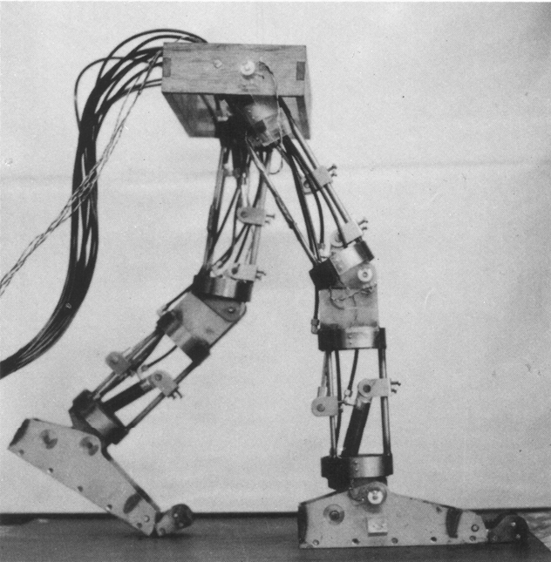
Basic Properties & Applications
Zero Moment Point (ZMP)
The ZMP is a theoretical point on the ground where the sum of all moments due to gravity and inertia equals zero; keeping the ZMP within the support polygon ensures dynamic stability during walking.
Mechanical Characteristics of ZMP Robots
Anthropomorphic design with articulated legs
Force/torque sensors in feet for ZMP measurement
Rigid structure to maintain dynamic stability
High-torque joints (especially at ankles) for precise CoM and foot control
Applications:
Humanoid service robots.
Research platforms for gait analysis, rehabilitation, and assistive robotics.
Industrial and entertainment robots requiring stable, human-like movement
WL-10RD: First robot with practical ZMP control, Waseda University (1984)

Slide 3
ZMP Robots: Benefits & Limitations
ZMP robots prioritize dynamic stability via active control, compared to passive dynamic walkers rely on mechanical design and gravity.
Benefits
Enables dynamically stable walking, running, and stair climbing.
Supports complex, human-like motion and manipulation tasks.
Well-understood theoretical framework and widely adopted in humanoid robotics.
Drawbacks
High computational demand for real-time ZMP calculation and feedback.
Sensitivity to sensor noise, model inaccuracies, and unexpected disturbances.
Typically less energy-efficient and less robust than passive or reflex-based bipeds

Slide 4
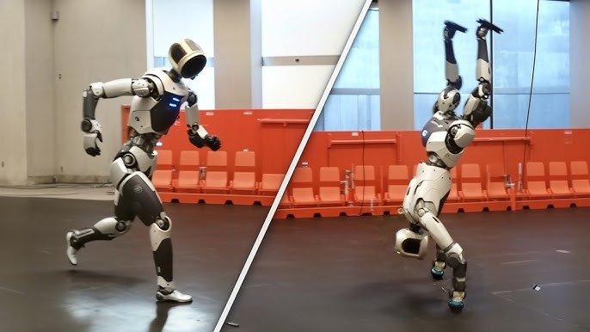
Atlas – Boston Dynamics
Fully electric, fifth-generation humanoid robot
Unmatched agility-walks, runs, jumps, climbs, manipulates heavy objects
Advanced real-time perception, AI, and whole-body dynamic stabilization
Designed for industrial, logistics, and automotive tasks-handles real-world environments and autonomous manipulation
Now positioned as a commercial product, with Hyundai and Toyota partnerships targeting factory automation

Slide 5
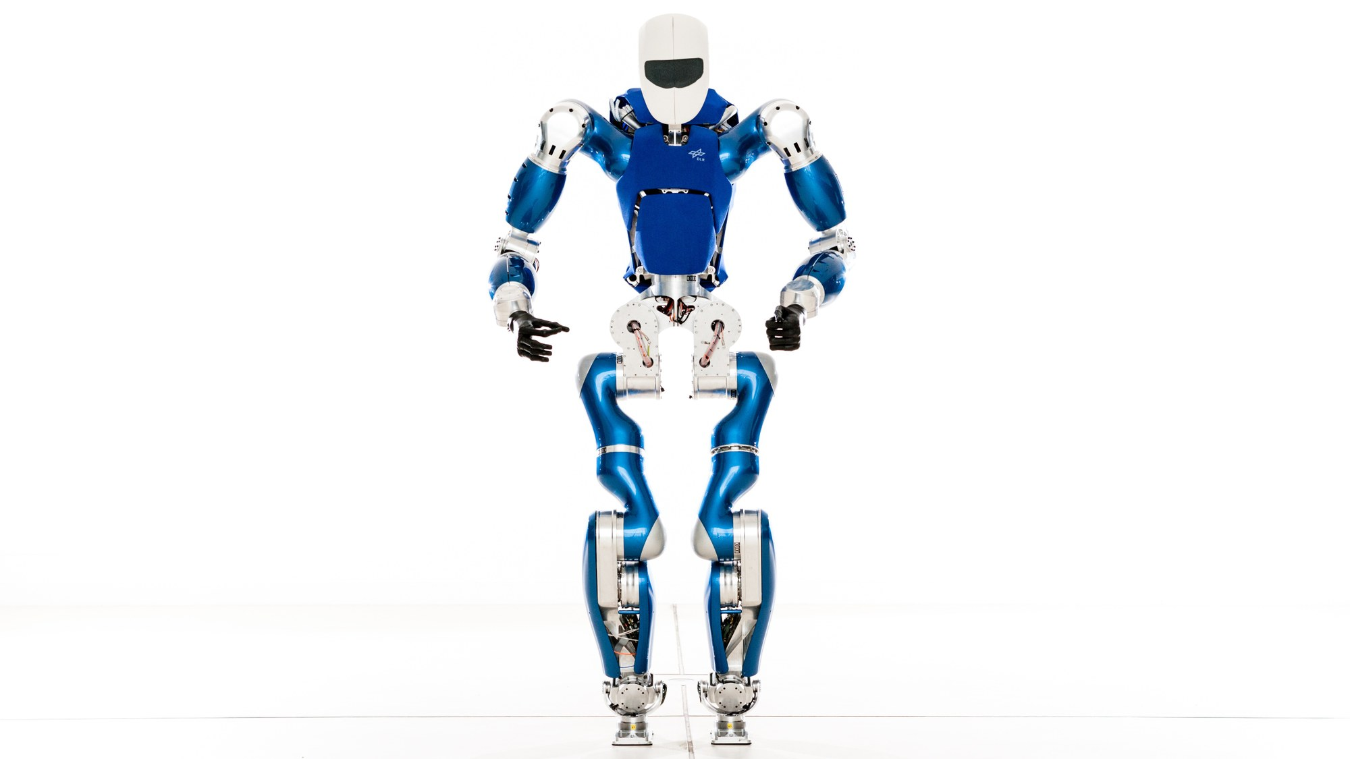
TORO Deutsches Zentrum für Luft- und Raumfahrt (DLR)
Technical facts
Measurements: Height: 1.74 m Weight: 76.4 kg
39 DOF
Focused on lightweight and high torque engineering
Materials: Al7075 alloy, carbon fiber
Actuators: BLDC and Servo motors
Sensors: Stereo cameras Inertial Measurement Unit (IMU) 6-axis force-torque sensors (feet)
Computer Architecture: two Intel R© Core i7 R© computers Real-Time Linux based on Kernel 3.0 Core2Duo & ARM7
Payload about 5kg per arm
Introduction to TORO
TORO: Torque-controlled humanoid robot
First public presentation: 2013
Research Focus
Fundamental problem: Balance control
Key research areas:
Robust walking
Stair climbing
Multi-contact scenarios (e.g., climbing, leaning)

Slide 6
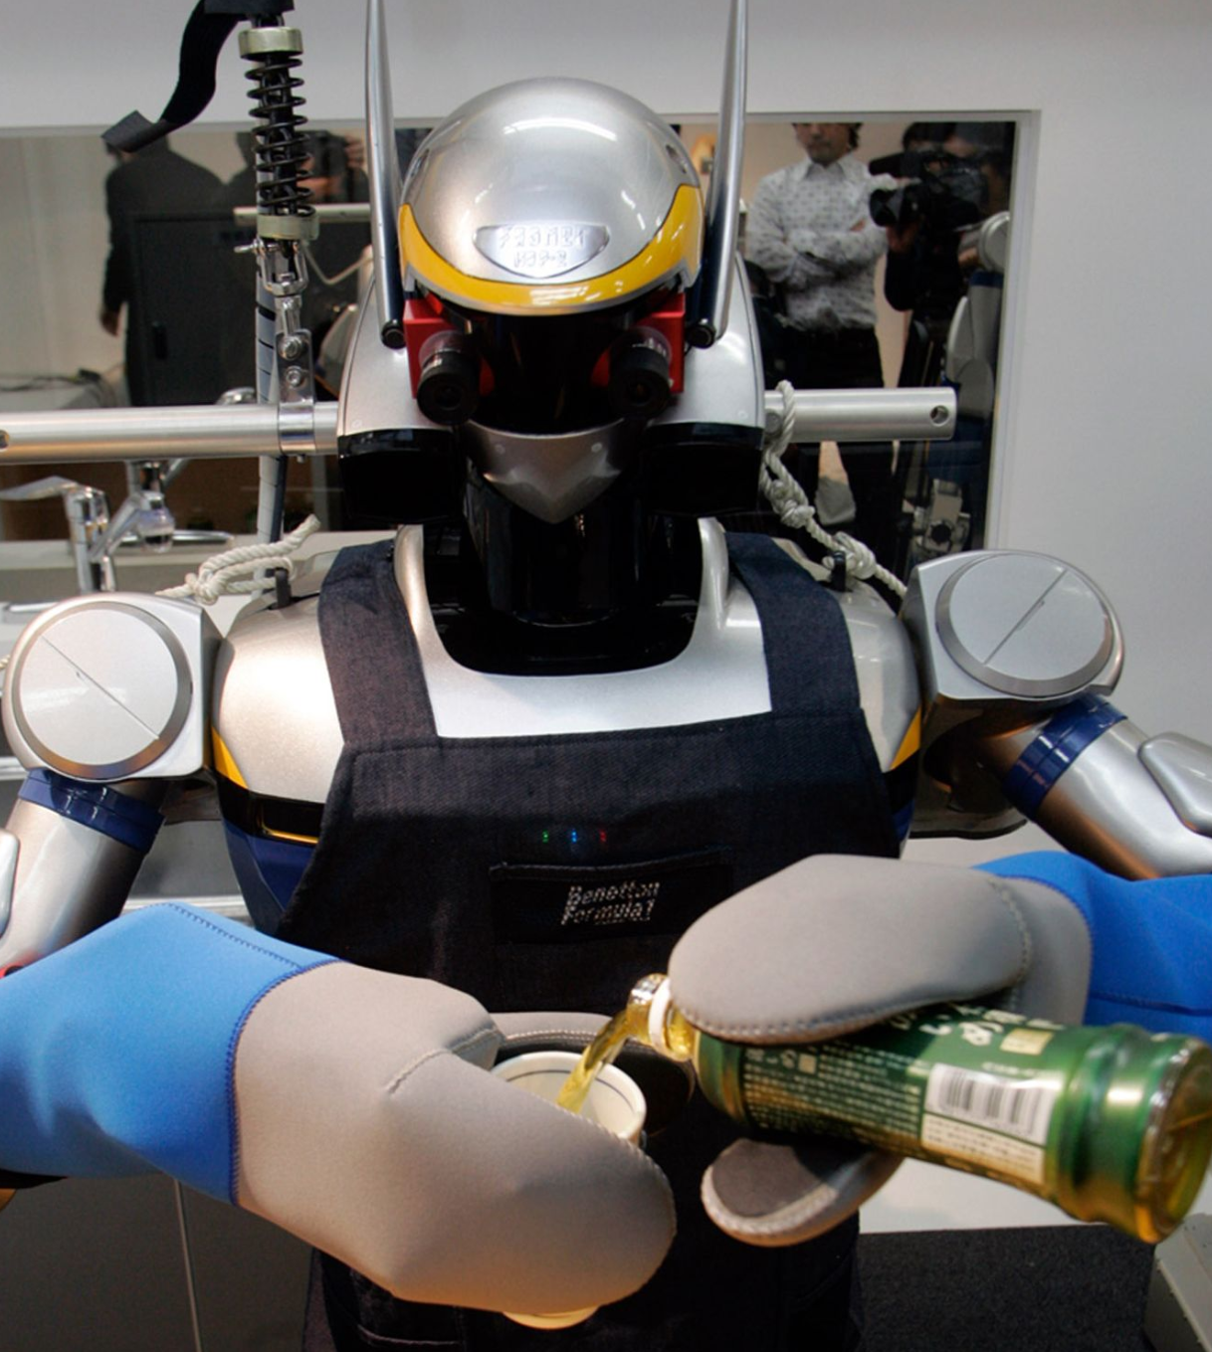
HRP-2 Promet Kawada Industry(川田工業）
Mass of 58 Kg
Body size of H 154 cm × W 65.4 cm × D 33.7 cm
Total DoF 30 ( double legs 6 × 2, double arm 7 × 2, waist 2, head 2）
Powered by 30 DC servo motor and harmonic gear drive
Standard walking speed 0.56 m/s
Walking cycle 0.24 step/s
Step length 0.23 m
Controlled by 2 industrial CPU boards (Pentium‑M class, Linux OS, 1 kHz servo loop)
Powered by 48-V 14.8-Ah nickel-metal hydride battery (available for 25 min)
Three cameras, three-axis gyro, three-axis accelerometer, 30 motor encoders, six-axis force sensors in the arms and legs
Classic ZMP‑preview humanoid; can climb 15 cm stairs, walk on a narrow beam, and recover from falls. Widely used as a research benchmark.
Picture source from https://robotsguide.com/robots/hrp2

Slide 7
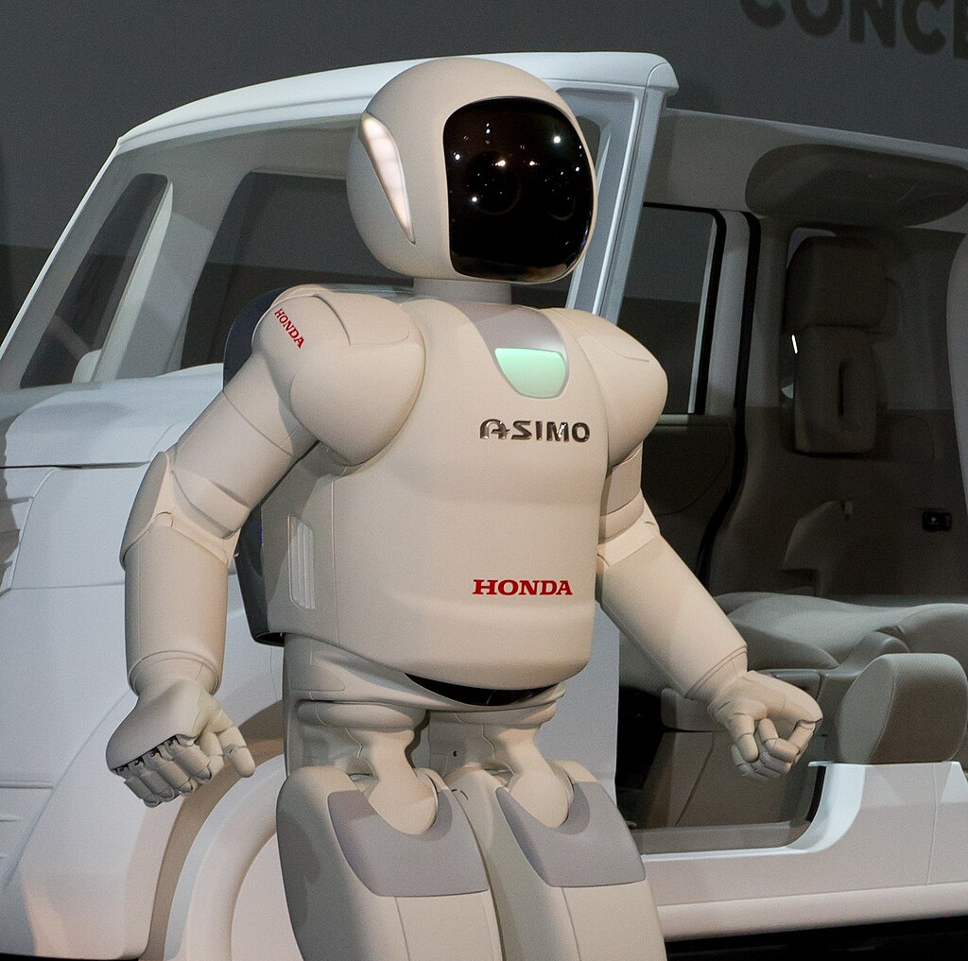
Honda – Asimo
1986 Initial dev of bipedal robots at Honda
Asimo line Introduced in 2000 by Honda Japan
First show in 2004
DOF (degrees of freedom) 57
Could run backwards and hop by 2011
Running speed 9 km/h
Weight 48 Kg
Battery life 1h (self charging)
I-walk allowed real time adaptive walking
Could push carts, hand over trays, pour drinks (using force and vision sensors)
13 DOF in each hand – capable of sign language
Voice and image/face recognition
Latest version/upgrade 2011
Deployed in museums demos and inspired disaster-response robots post-2011 Fukushima accident
Halted research in 2018
Last appearance March 2022
Robot ASIMO (version 5) at the Tokyo Motor Show 2011.​

Slide 8


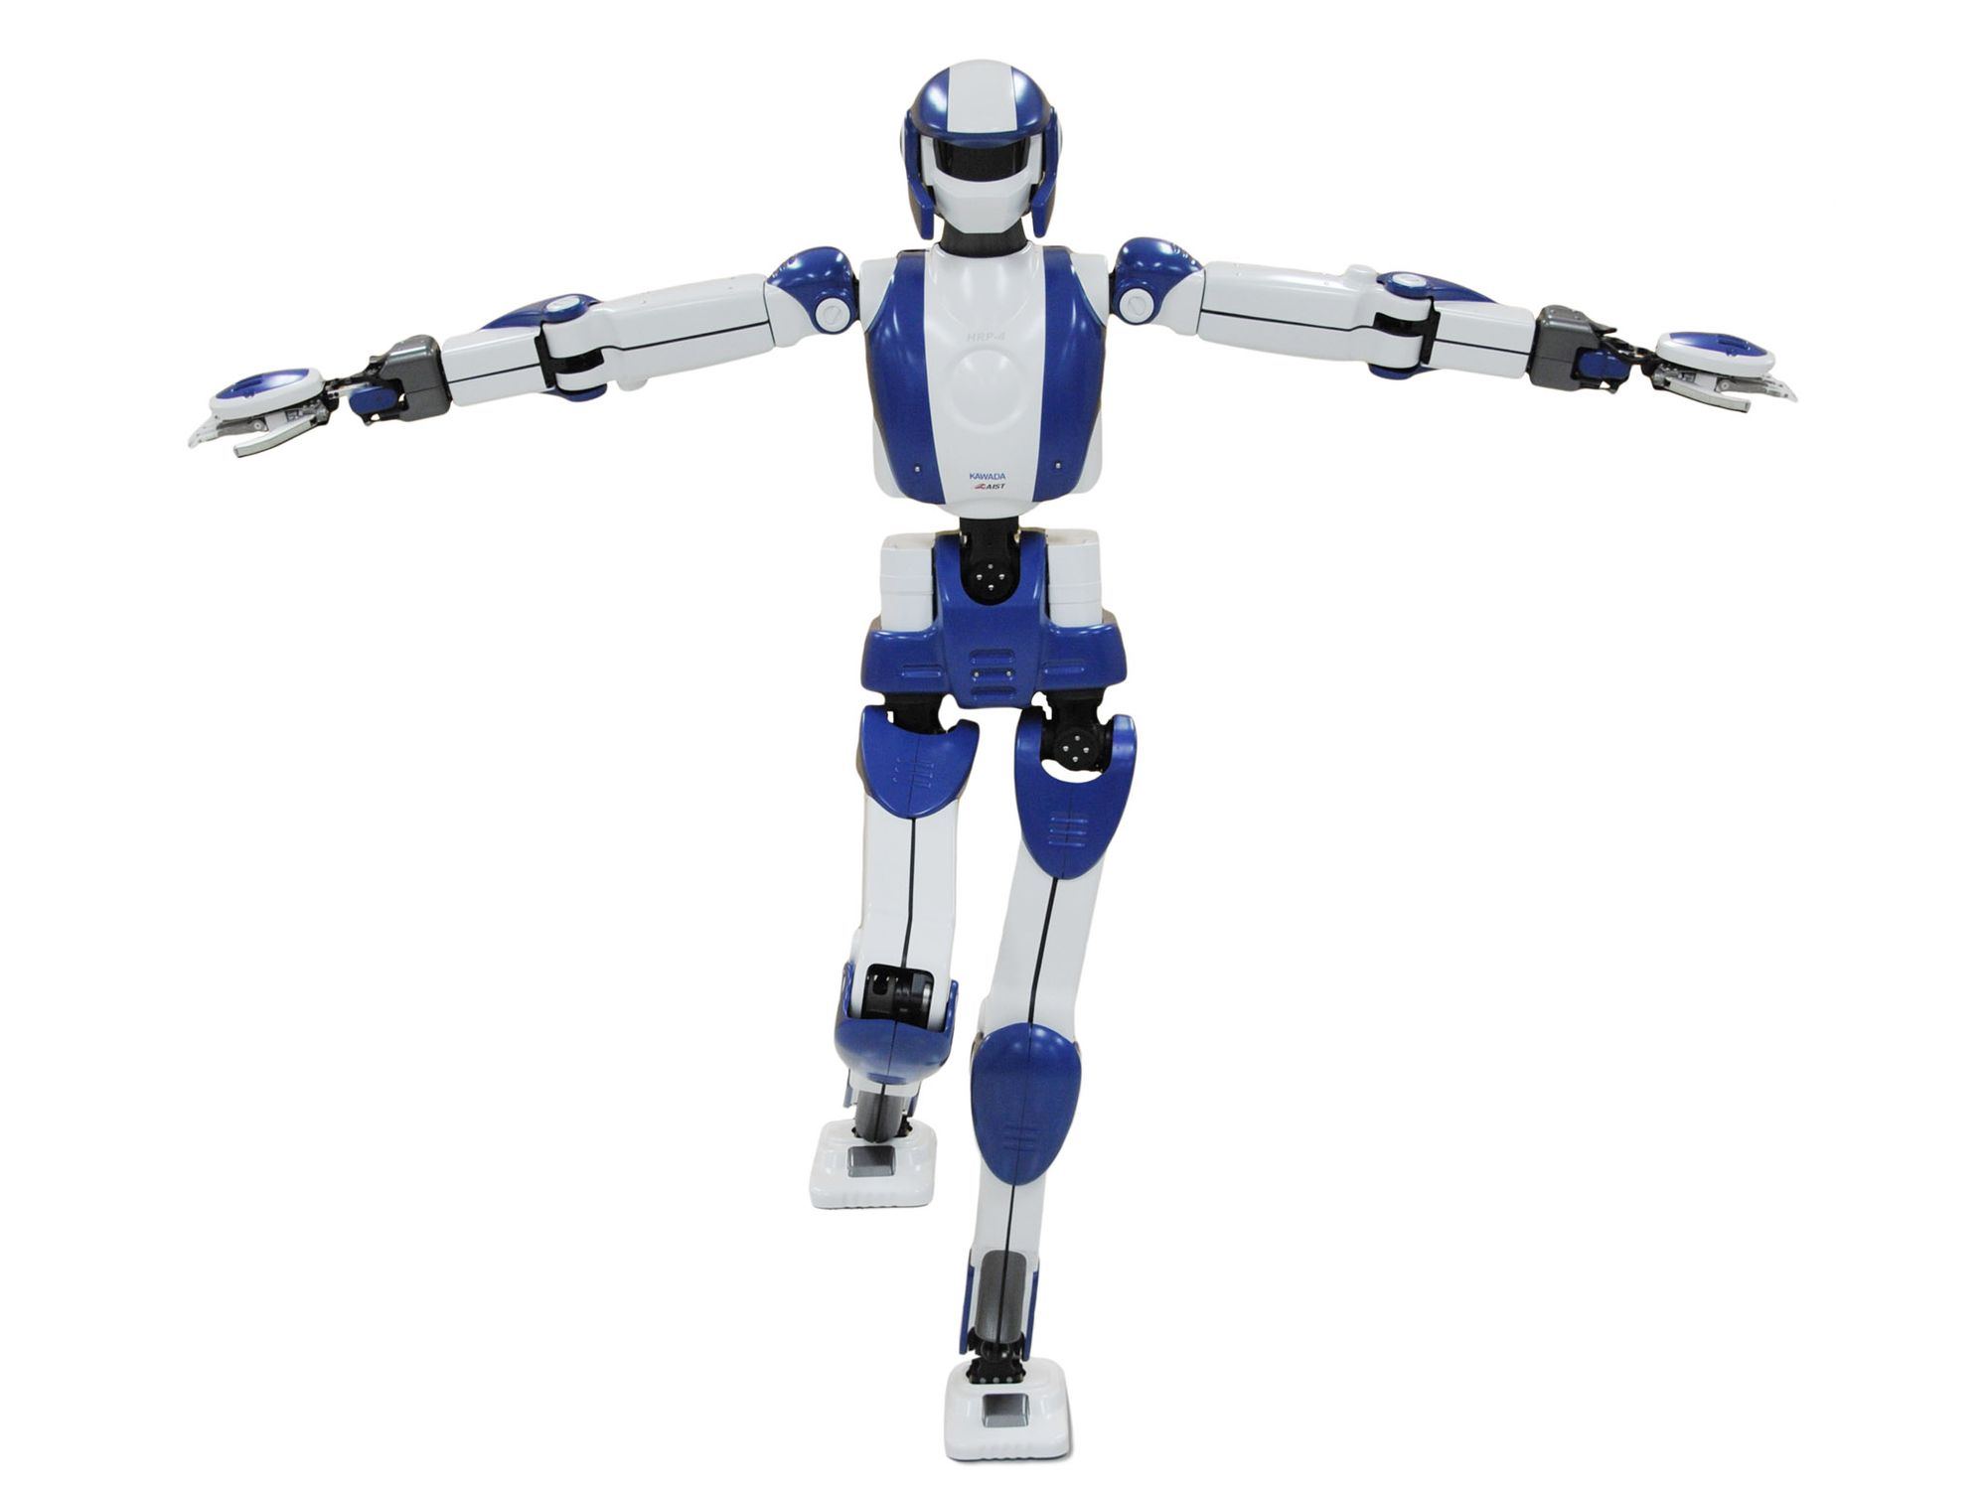

Developed in 2010 by:
Kawada Industries and National Institute of Advanced Industrial Science and Technology (AIST)
Technical Details:
Lightweight and slim design (151 cm tall, 39 kg)
34 Degrees of Freedom
Utilizes ZMP-based control for stable bipedal locomotion
Payload of each arm: 0.5 kg
Low power motors operating at 80 W
Max Walking Speed: 0.4375 m/s
Purpose:
A research and development platform for next-generation humanoid robots, aiming to assist in tasks such as manual labor and to address labor shortages due to an aging population.
Photo: Kawada Industries/AIST

Slide 9
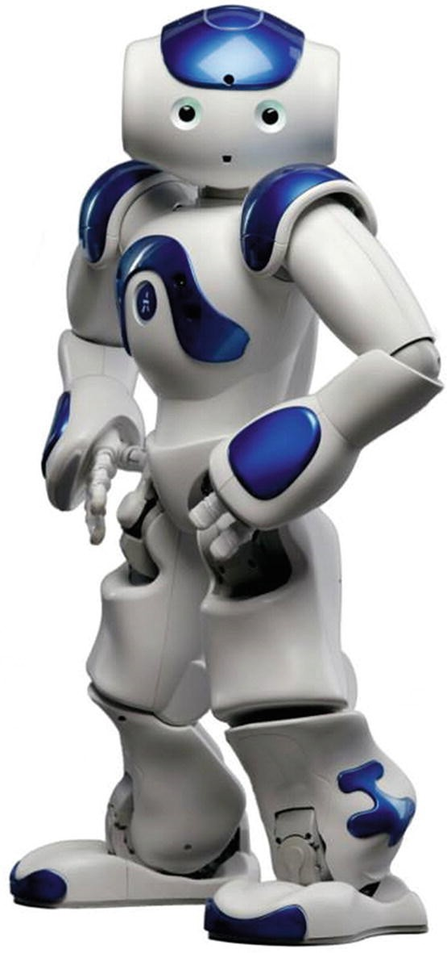
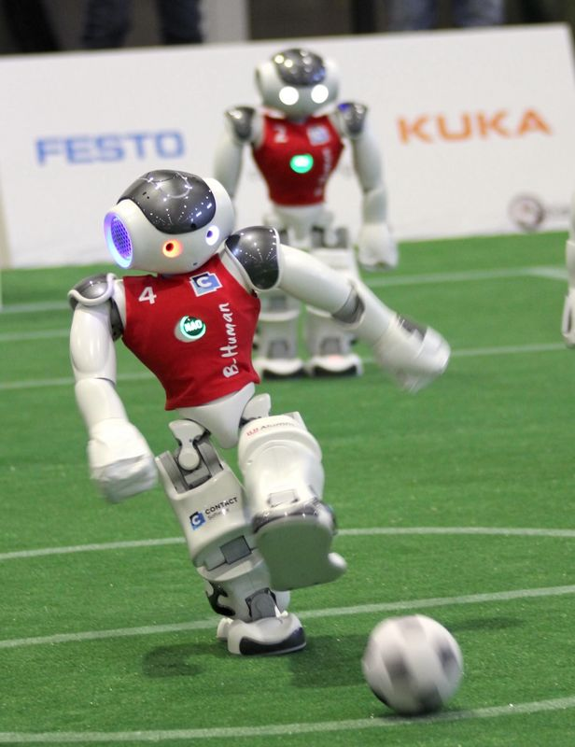
SoftBank NAO A Compact Humanoid with ZMP-Based Balance
Who Developed It? 🧠
• Developed by Aldebaran Robotics (France), now SoftBank Robotics
Purpose 🤖
• Built for education, research, and social interaction
Key Features ⚙️
• Height: 58 cm, Weight: 5.5 kg
• 25 Degrees of Freedom, HD cameras, IMU, foot pressure sensors
• Walk speed: ~0.08 m/s, up to 1.6 km/h in RoboCup matches
ZMP-Based Walking 🦿
• Uses ZMP preview control with LIPM model
• CoM is adjusted to keep ZMP stable

Slide 10
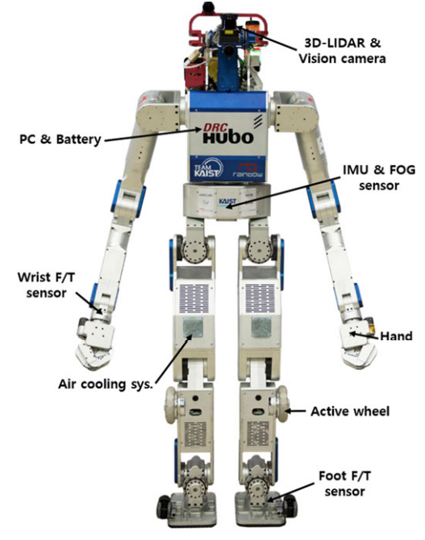
DRC HUBO+
Developed by KAIST HUBO Lab (South Korea)
Created in 2015 for the DARPA Robotics Challenge
Stands 170 cm tall and weighs 80 kg
Features 32 degrees of freedom for human-like mobility
Walking Speed: Up to 1.8 km/h (0.8 s per step)
Uses cameras + 2D LiDAR for environment perception
Runtime: Up to 4 hours on battery power
Mobility Tasks: Drives, walks, climbs stairs, traverses rubble, and switches to wheeled mode for speed/stability
Manipulation Tasks: Opens doors/valves, drills, clears debris, and performs tool-based operations
🥇 Won 1st place in DARPA Robotics Challenge 2015

Slide 11
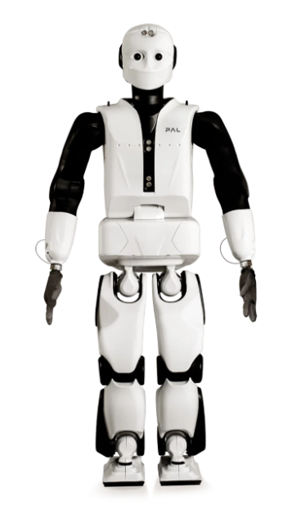
REEM-C
Developed by:
PAL ROBOTICS
Technical Details:
Height: 165 cm
Weight: 80 kg
Hand Payload: 1 kg (with arm fully stretched)
Battery Autonomy: 3 hours walking / 6 hours stand-by
Torque Sensors: Located in ankles and wrists
Operating System: Linux (Ubuntu) with ROS
Purpose:
A research and development platform that can walk stably at a speed of up to 2.5 km/h, and can even climb stairs or sit on a chair. Provided with a large autonomy, it is the right biped robot to bring research in robotics and Artificial Intelligence one step ahead.

Slide 12
References
Timofte, G., & Han, M.-W. (2008). Control of a humanoid robot based on the ZMP method. ScienceDirect.
Hu, K., Ott, C., & Lee, D. (2014). Online Iterative Learning Control of Zero-Moment Point for Biped Walking Stabilization. Technical University of Munich.
Borovac, B., Potkonjak, V., & Surla, D. (2011). ZMP: A Review of Some Basic Misunderstandings. International Journal of Humanoid Robotics.
Vukobratović, M. (2001). Zero-Moment Point-Thirty Five Years of Its Life. IAS TU Darmstadt.
Wang, Y., & Yu, H. (2020). Foot-guided control of a biped robot through ZMP manipulation. Advanced Robotics.
Ackerman (2011). Honda Robotics Unveils Next-Generation ASIMO Robot. IEEE Spectrum
Shigemi S., (2019). ASIMO and Humanoid Robot Research at Honda. Honda R&D Co., Ltd.
KYODO NEWS (2022). Honda's Asimo robot retires after 20-year career wowing public
Hondanews.eu (2014). All-New ASIMO https://hondanews.eu/eu/fi/cars/media/pressreleases/35508/all-new-asimo
Jung, T., Lim, J., Bae, H., Lee, K. K., Joe, H.-M., & Oh, J.-H. (2018). Development of the humanoid disaster response platform DRC-HUBO+. IEEE Transactions on Robotics, 34(1), 1–17. https://doi.org/10.1109/TRO.2017.2776287
“HRP‑2,” ROBOTS: Your Guide to the World of Robotics, Robots Guide, IEEE Spectrum. [Online]. Available: https://robotsguide.com/robots/hrp2. [Accessed: 12‑May‑2025].
National Institute of Advanced Industrial Science and Technology (AIST). (2010, November 8). Development of HRP-4. Retrieved from https://www.aist.go.jp/aist_e/list/latest_research/2010/20101108/20101108.html
Röfer, T., & Müller, J. (2009). Omnidirectional walking using ZMP and preview control for the Nao robot. RoboCup Symposium.

